Slide 1

w

Slide 2
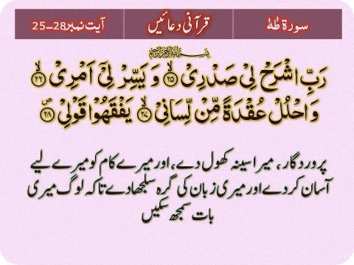

Slide 3

curiosity about life in all of its aspects is still the secret of great creative peoples.

Slide 4
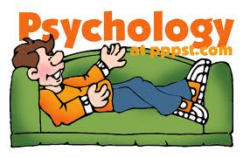

Slide 5
Objectives
In the end of this session you would be able to explain
1- what is psychology ?
2-psychology is a sciences or still a phenomena ?
3-what does mean by coping mechanism ?
4-which one is your coping mechanism ?
5-is it healthy or un health ?
6-How we can help others ?

Slide 6
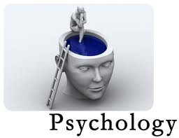

Slide 7
PSYCHOLOGY
scientific study of behavior and mind

Slide 8
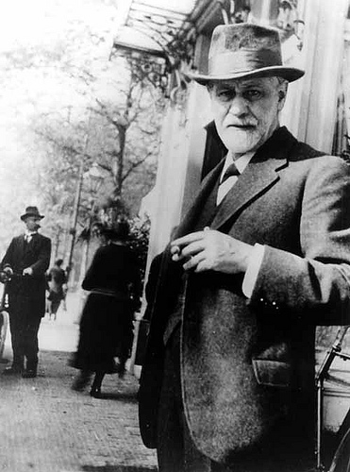
1856-1939
Sigmund Fruied(1856-1939)

Slide 9
Friedan theory
Psychoanalysis
Id (Individual therapy)
Ego
Super ego
Councious-subcouncious-uncouncious
(young, ,Adler,,,,,,)

Slide 10
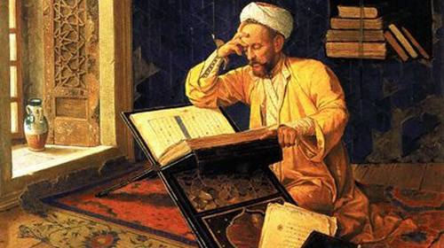
Mohammad al-Ghazzālī (1058–1111)

Slide 11
Imam gazali
Nafse lawama (Reading therapy)
Nafse mutmeana
Nafse ammara
Ashraf Thanvi, Mullana Madoodi,,,,,,,,,,,,,,,,,,,,,,,,,

Slide 12
Behaviorist
(Learning and Modeling school of thought)
Behavior Modification
J .B .Watson

Slide 13
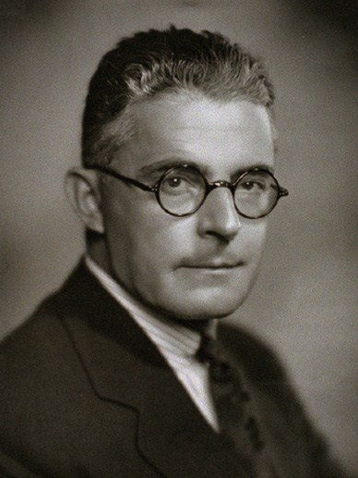
John B. Watson (1913).
First published in Psychological Review, 20, 158-177
John B. Watson (1913).
First published in Psychological Review, 20, 158-177
John B. Watson (1913).
First published in Psychological Review, 20, 158-177
Wson (1913).
First published in Psychological Review, 20, 158-177
JOHN .B. WATSON (1878-1958)

Slide 14


Slide 15
Psychology
Behavior Mental Process
psychology as science

Slide 16
Psychology
Behavior Mental Process
walking ←
Talking ←
Eating ←
Crying ←
We learn behavior through Punishment and Reward (pave love and skinner)
Behavior therapy

Slide 17
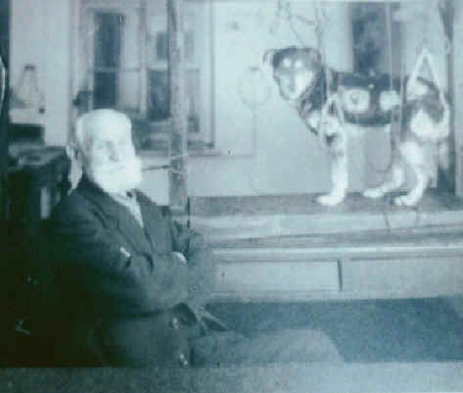
pave love and skinner
(1849-1936)

Slide 18
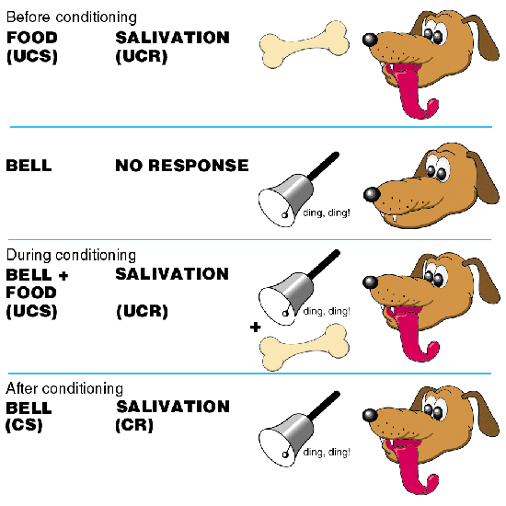

Slide 19
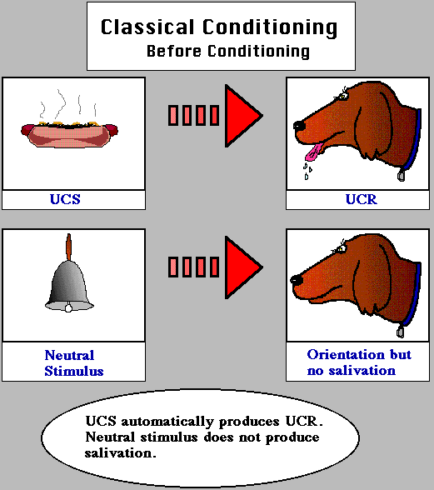

Slide 20
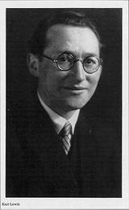
Kurt Lewin
Father of social psychology
1935-1945

Slide 21
Social Cognition
How we think
The World Other People Ourselves
Professor: Dr. Steve Spencer
My office is 3043 PAS
My phone # is 3046
Email account is sspencer@watarts.uwaterloo.ca

Slide 22
Attitudes and Behaviors
Other influences
Expressed Attitude (subjective)
Attitude
Behavior (subjective)
Other influences

Slide 23

Punishment reward and Modeling
Principle
works for average IQ people

Slide 24
Cognitive therapist (Aaron T Beck)
Psychology
Behavior Mental process (cognition)
→ Thinking (concrete, abstract,
Ideas, creativity)
Learning → Memory
→ Perception
→ Problem solving
→ Design making
Cognitive - Behavior therapy

Slide 25
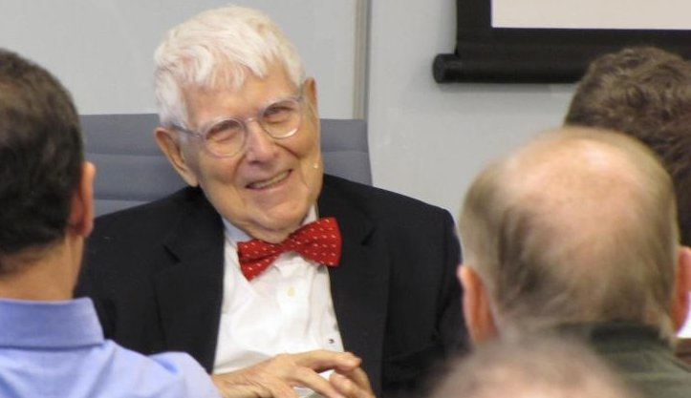
,
1960's, Aaron T Beck,,,,,

Slide 26
Aaron T Beck,
American psychiatrist and a professor emeritus in the department of psychiatry at the University of Pennsylvania.
www.beckscales.com.
Beck Youth Inventories of Emotional and Social Impairment®(BYI®)– Second Edition (For children and adolescents ages 7-18)
Beck Anxiety Inventory® (BAI®)
Beck Depression Inventory® (BDI®)
Beck Scale for Suicide Ideation® (BSS®)
Beck Hopelessness Scale® (BHS®)
Clark-Beck Obsessive-Compulsive Inventory® (CBOCI®)
BDI® - Fast Screen for Medical Patients

Slide 27
Humanistic
Psychology
Behavior Mental process (cognition)
→ Thinking
Learning → Memory
→ Perception
→ Problem solving
→ Design making
Individual differences , uniqueness , human feelings

Slide 28


Slide 29
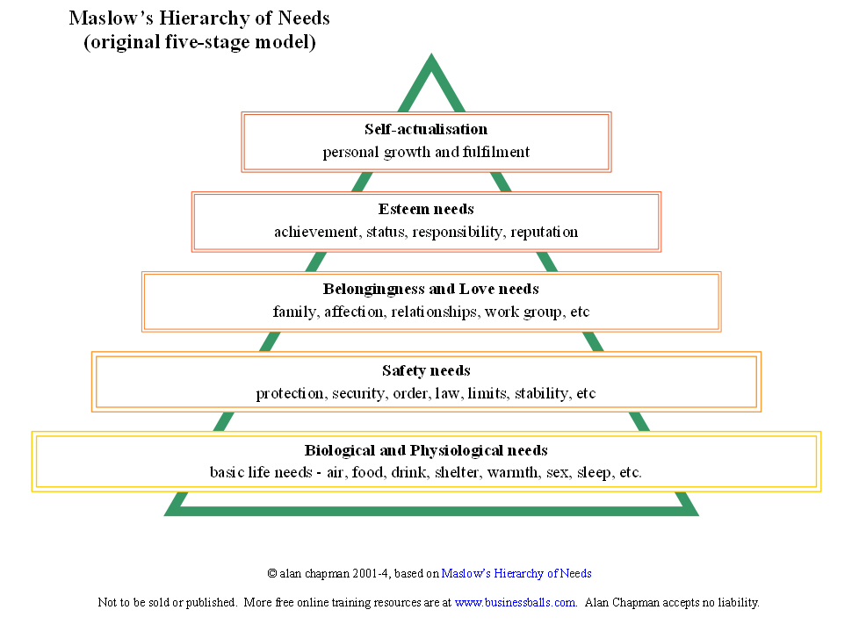

Slide 30
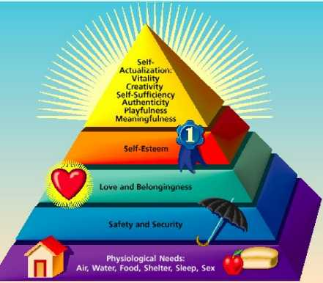
i
Humanistic theory (counseling skill)
Hierarchy of needs
that motivate us
Motivation for Achievement
Motivation for Power
Motivation for Affiliation

Slide 31
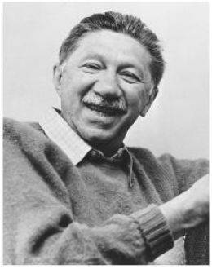
Abraham Maslow
1908-1970

Slide 32
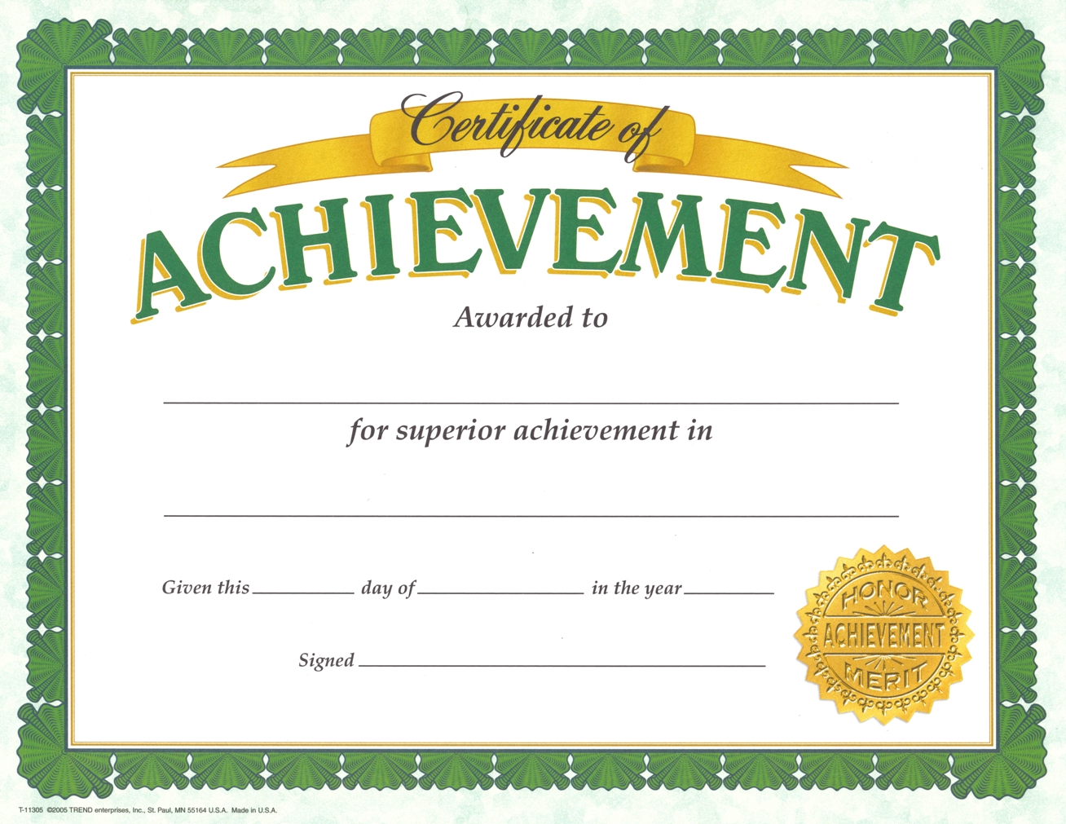
Motivation for Achievement (subjective)

Slide 33
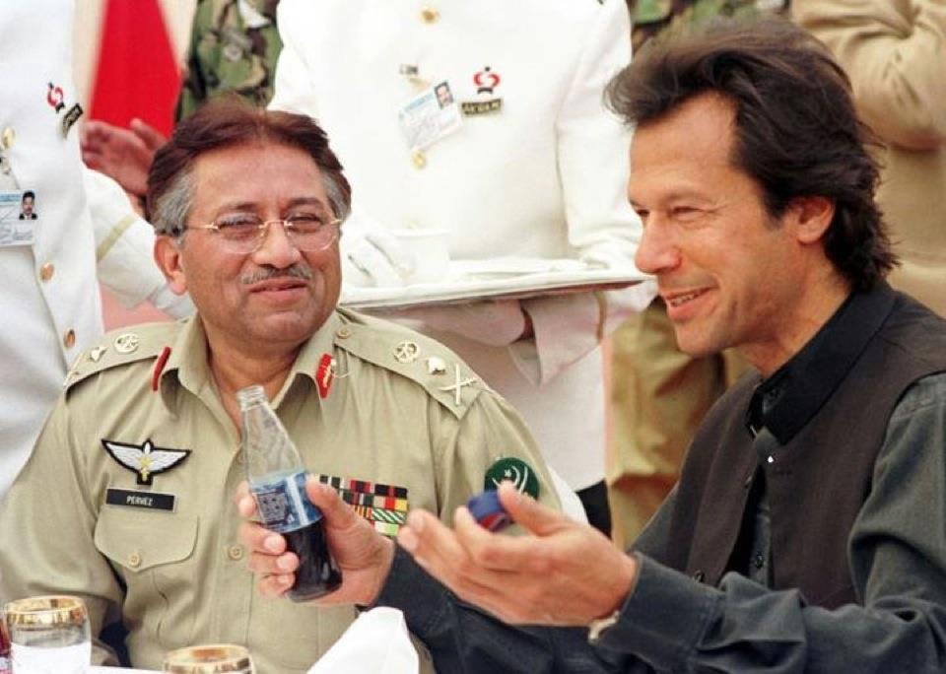
Motivation for power (objective)

Slide 34
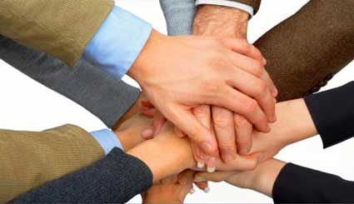
Motivation for Affiliation (partial)

Slide 35
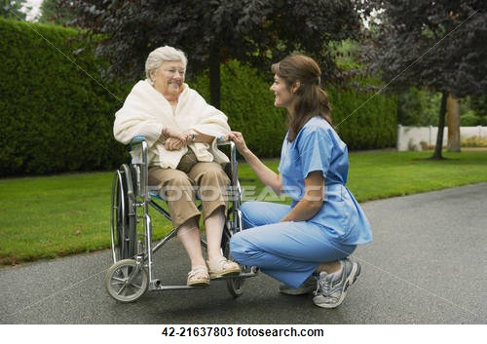
Empathy is moor effective then Sympathy

Slide 36
Psychology
Behavior Mental process
(cognition) (Affection)
(IQ) (EQ)
→ Thinking → Feelings
→ Memory → Emotions
→ Perception → Moods
→ Problem solving
→ Design making

Slide 37
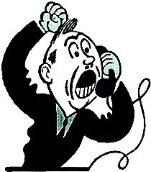

Slide 38
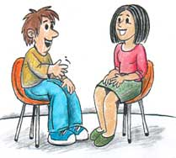
c
Cognitive Behavior Processing Therapy

Slide 39
Gestalt therapist
(Holistic approach)
Frederick(he wrote a lot of books on topic of)
ego status,
people play games,
and Empty chair

Slide 40
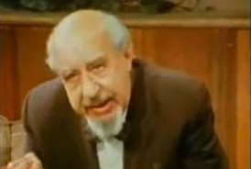
Frederick (Fritz) and Laura Pearls in the 1940s.

Slide 41
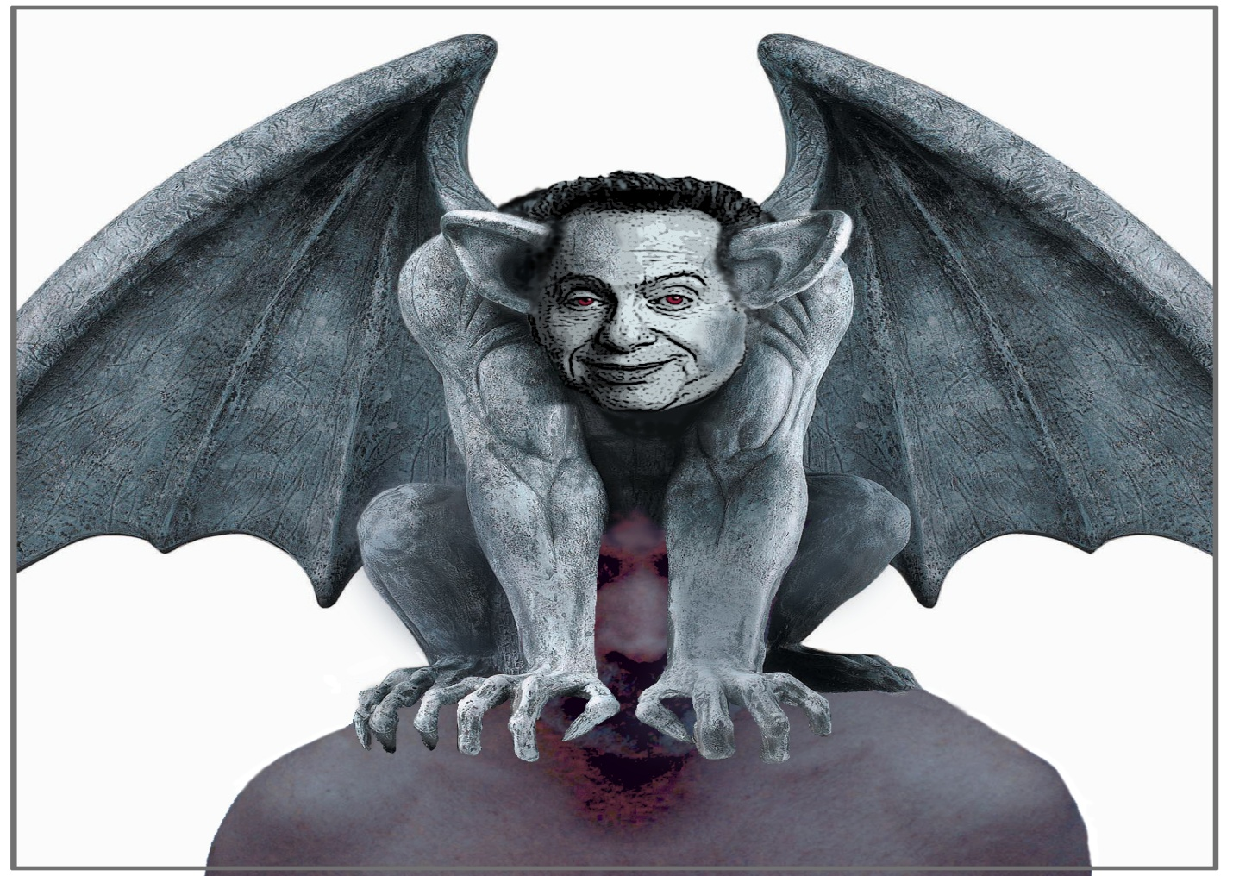
visual perception

Slide 42
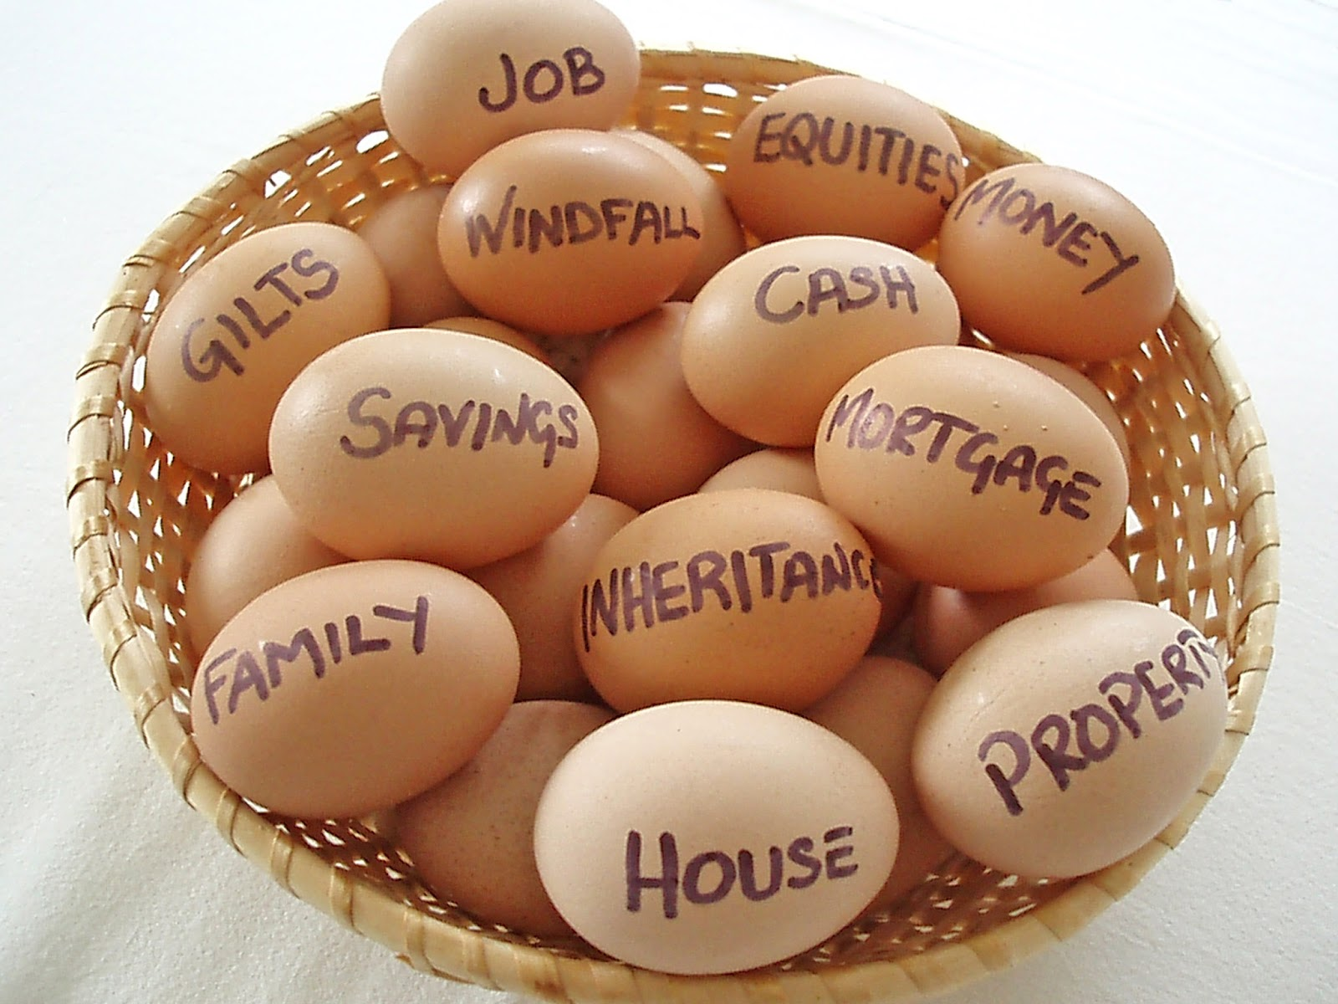
Holistic approach

Slide 43
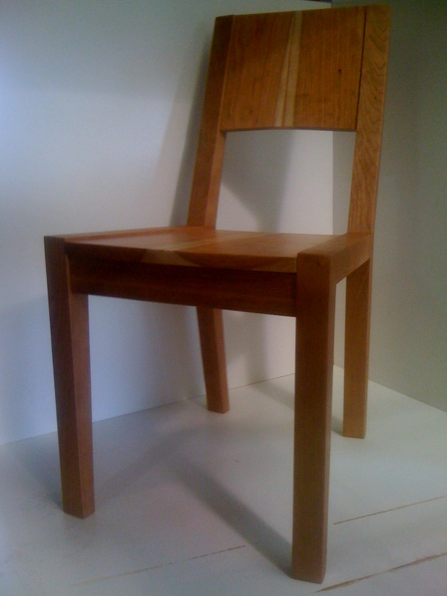
Empty chair
Positive emotions
Negative emotions
Disclosures (HIV)

Slide 44
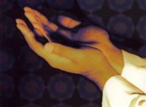
Duaa

Slide 45

Mental Process
cognition(IQ) Affection(EQ)
moods
feelings
emotions
heart beat

Slide 46
Julie Reinhold, an NY State licensed clinical psychologist
Our intense emotions reveal our need for heart change. In fact, our ability to regulate emotions can be an indication that our hearts are being transformed.
http://www.redeemer.com/care/counseling/staff.html#reinhold

Slide 47
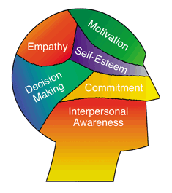
Emotional Intelligence

Slide 48
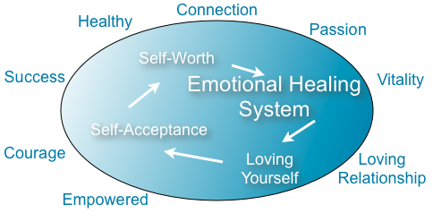

Slide 49
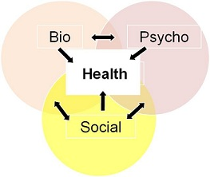

Slide 50
Para Psychology (Body Energy)
Positive energy Negative energy
Spiritual Evil soul
(constructively) (destructivity)

Slide 51
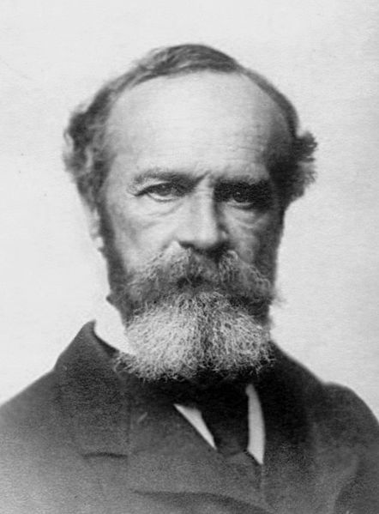
First Para Psychologist
William James (1906)

Slide 52
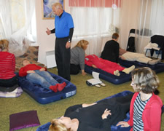
Richey Healing Hands Therapy

Slide 53
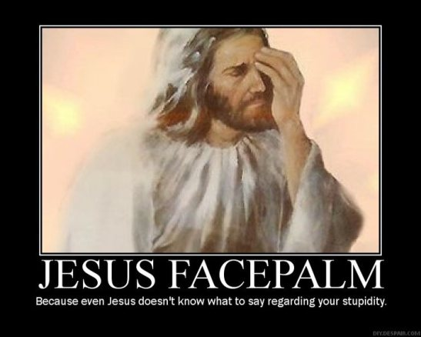

Slide 54
Journals dealing with parapsychology include the Journal of Parapsychology, Journal of Near-Death Studies, Journal of Consciousness Studies, Journal of the Society for Psychical Research and Journal of Scientific Exploration

Slide 55


Slide 56


Slide 57
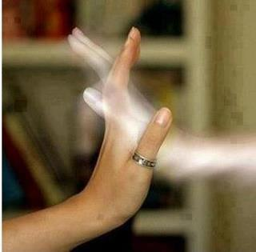
Spiritual experiences

Slide 58


Slide 59
Quantitative analysis
Qualitative analysis

Slide 60
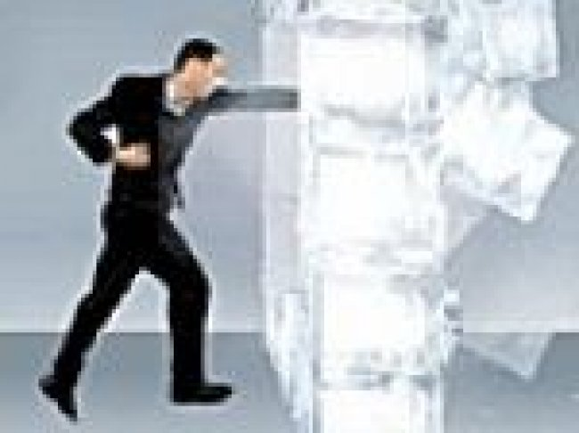
Icebreaker

Slide 61
What is soul ?
Do you have any experience

Slide 62
Mental process (cognition) (Affection)
(IQ) (EQ) Thinking Feelings
Memory Emotions
Perception Moods
Problem solving
Design making
Attacks

Slide 63
Attacks
Negative emotions
Unpleasant feelings
Guilt feelings
Shame
Hearted

Slide 64
Mental process (cognition) EGO (Affection)
(IQ) (EQ) Thinking defense Feelings
Memory mechanism Emotions
Perception Moods
Problem solving
Design making
(Strong Ego)

Slide 65
Mental process (cognition) (Affection)
(IQ) (weak ego) (EQ) Thinking Feelings
Memory Emotions
Perception Moods
Problem solving
Design making

Slide 66
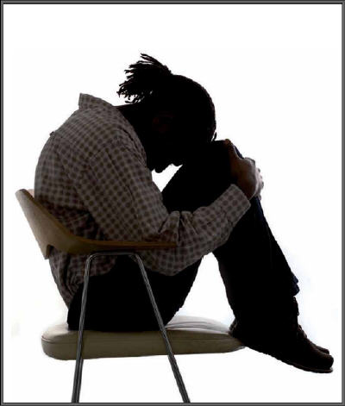
Ego melt down, guilt, fail coping

Slide 67
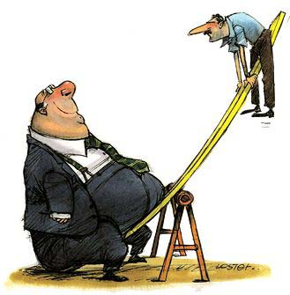

Slide 68
Ego defense mechanism
safeguard and emergency tools to cope with unpleasant feeling and negative emotions these defense mechanism strengthen the ego functioning

Slide 69
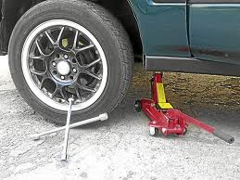
Defenses are Emergency tools

Slide 70
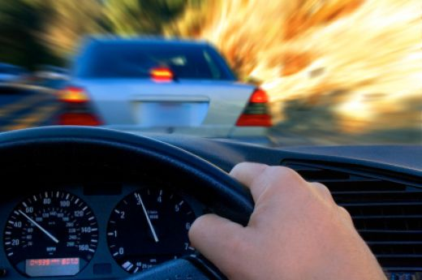
You are the driver

Slide 71
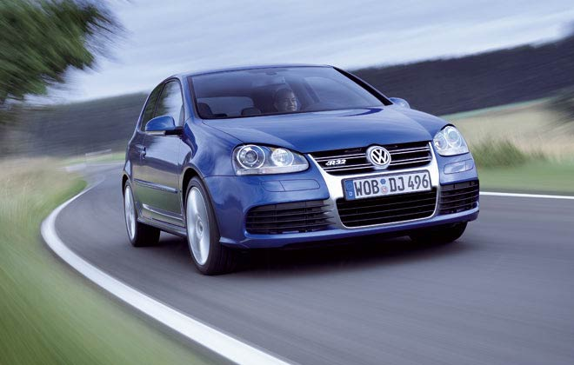
This is your life

Slide 72
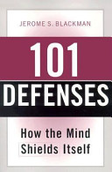

Slide 73
11 – recommended, healthy, positive
Ego defenses .strengthen the ego
functioning
11 – unhealthy, poor, weak Ego defense
that lead to depression, suicide, addiction.

Slide 74

Healthy ego defense mechanism maintain your
personality

Slide 75
Become habitual of any defense mechanism could be source of ,,,,, negative out comes.
So may concern to some trusty person for sharing or some counseling to resolve it.

Slide 76

sharing

Slide 77
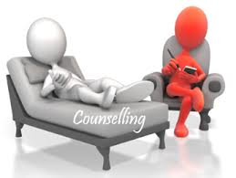
counseling

Slide 78
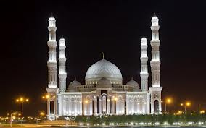
Religious place
The Best Counseling place

Slide 79

Counseling gives you the way and clarity of thoughts

Slide 80
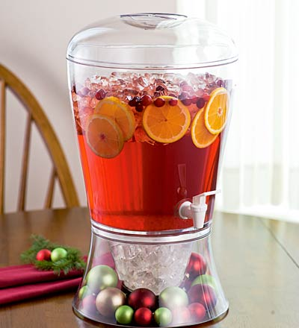


Slide 81
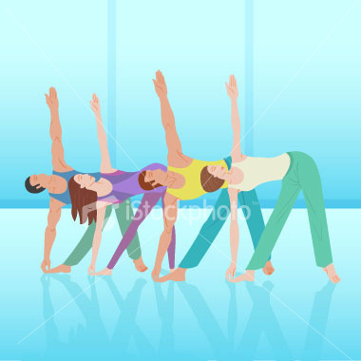
Healthy ego defenses

Slide 82
Icebreaker

Slide 83
?
Lets find out our coping mechanism ?

Slide 84

Unhealthy, poor, weak Ego defense

Slide 85
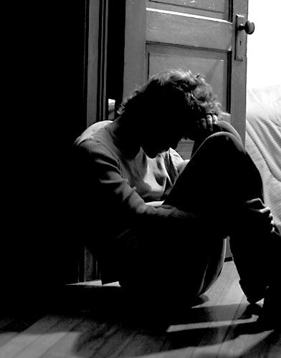
Lead to depression

Slide 86
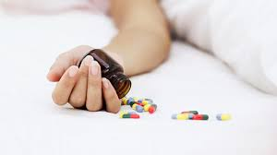
suicide

Slide 87
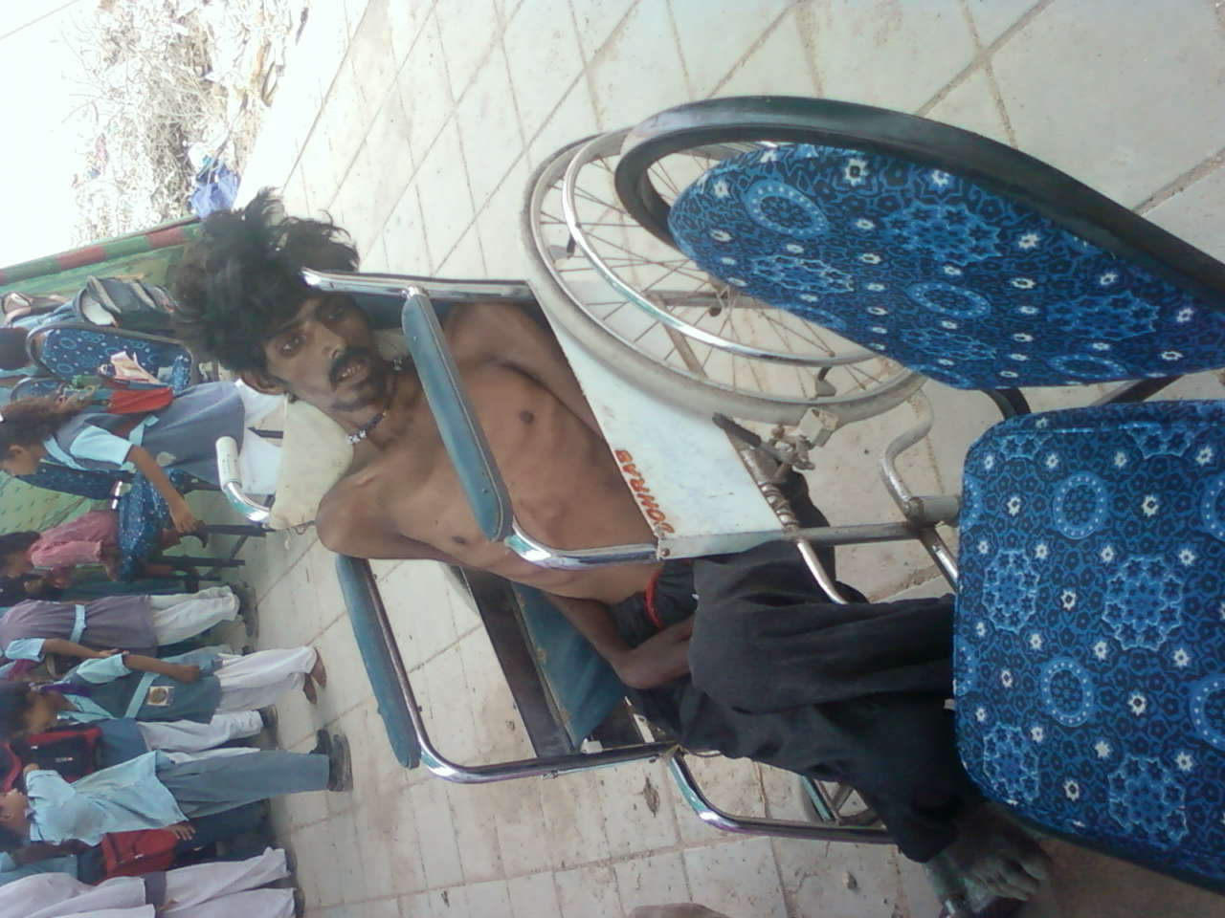
Drug addiction

Slide 88
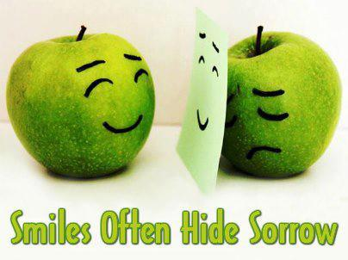

Slide 90

Thank you for your time
Sumara Rashid Khanzada
Rehab-Clinical Psychologist

